Slide 1
Time Tracker
Challenge:
The file is formula based. So any change in the formula may not give the correct tracking.

Slide 2
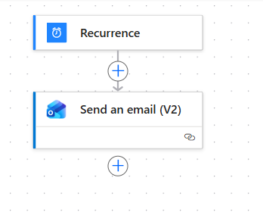

Slide 3
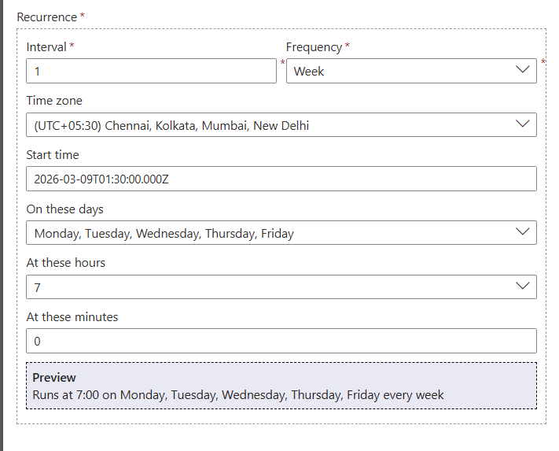

Slide 4
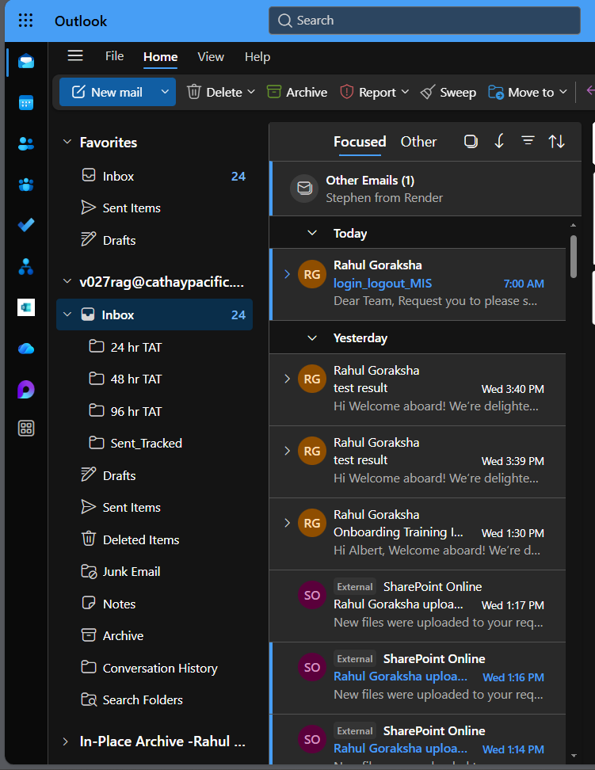

Slide 5
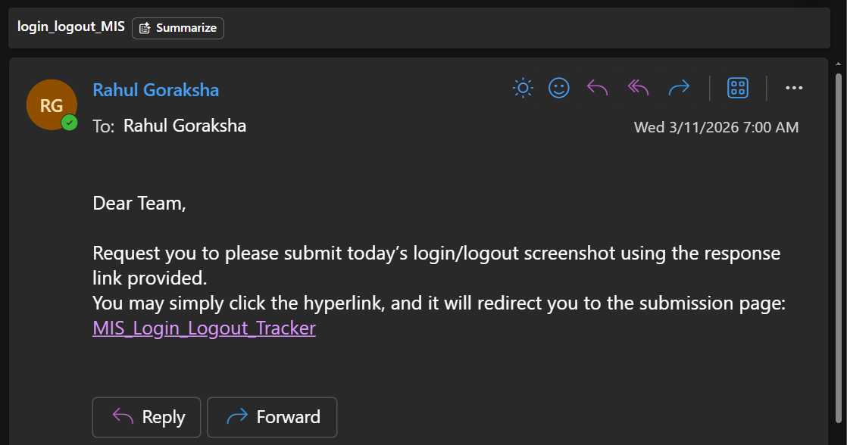

Slide 6
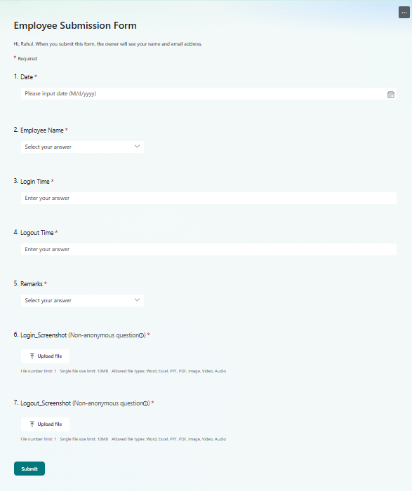

Slide 7


Slide 8
